Slide 1
Division of Land Resource Protection
Preserving our Natural Resources
Lesson 1: Protecting our Farmlands

Slide 2
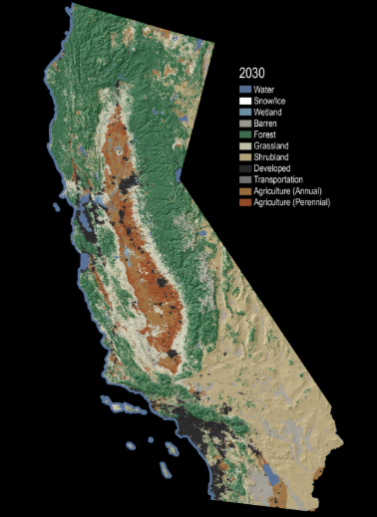
https://www.usgs.gov/media/images/animated-map-projected-land-change-california-2001-2100
The Future of California’s Changing Landscape
Record your observations in your science notebook.

Slide 3
Making Predictions
What factors do you think were included in the model to create the simulation?
Let’s examine any patterns of change in the Antioch area from land use data from 1984 to 2008.

Slide 4
Changes in California Farmlands
Make 5-10 observations about the animation or picture and write your observations in your science notebook.
Generate 2 questions from your observations.
What do you think each color represents (Green, Blue, Grey/Brown and Red)?

Slide 5
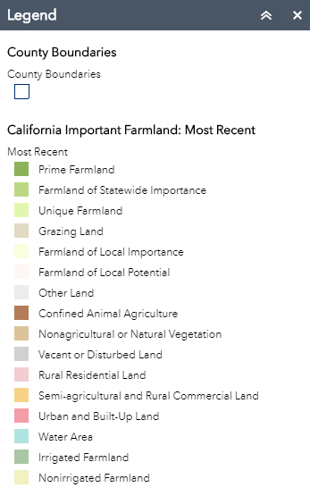
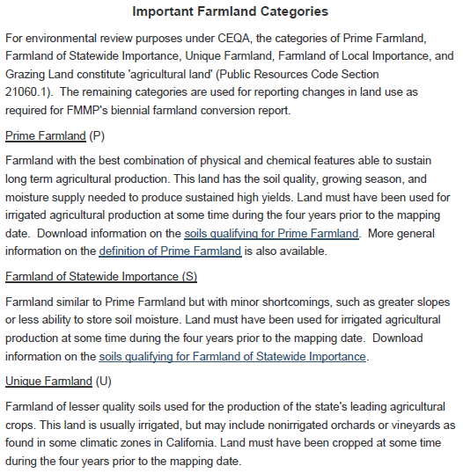
Making Observations & Analyzing Data

Slide 6
Sharing Observations
Share your list and questions with your partner and generate a longer list of observations and identify at least two additional questions that you would like to investigate further.

Slide 7
Change and Stability
How did agriculture change between 1984 - 2008?
Make a claim using evidence from the simulations about how agriculture has changed over time. How might we further support your current claim?

Slide 8
Perennial vs. Annual
Perennial plants survive and produce multiple-years. Examples of perennial plants grown for agriculture include kale, garlic, asparagus, orchards, vineyards, bush berries, alfalfa,and artichokes.
Annual plants have a one-year growing season. Examples of annual plants includes corn, wheat, rice, lettuce and peas.

Slide 9
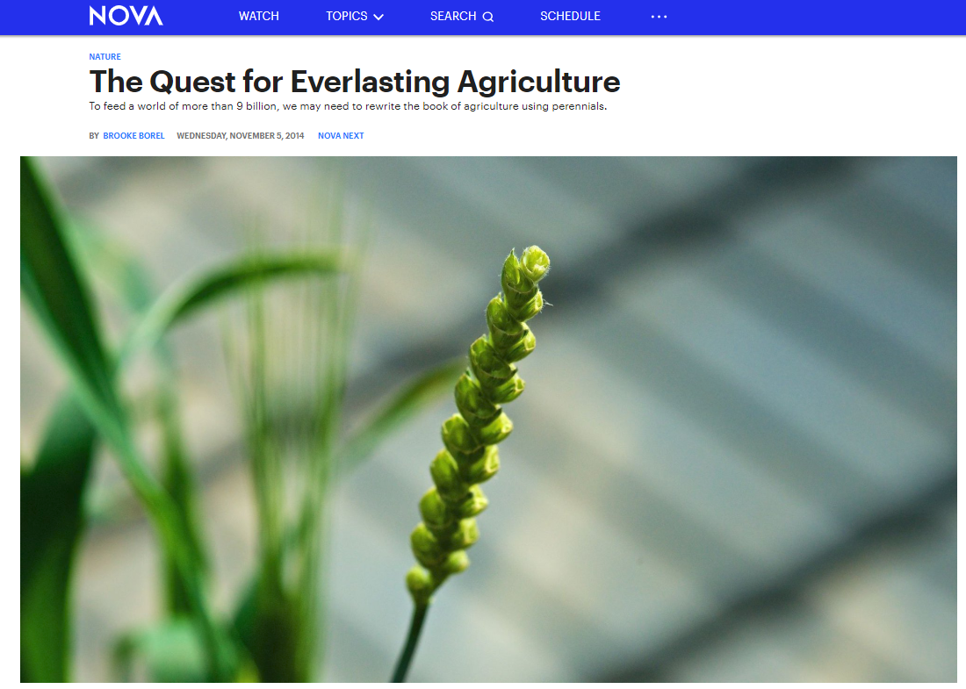
The Quest for Everlasting Agriculture
Revisit your claim and think about what type of crops will be grown in the future.
https://www.pbs.org/wgbh/nova/article/perennial-agriculture/

Slide 10
Changing Farmlands
What is one component of the model (simulation) at the beginning of the lesson that we investigated?
Agricultural Use

Slide 11
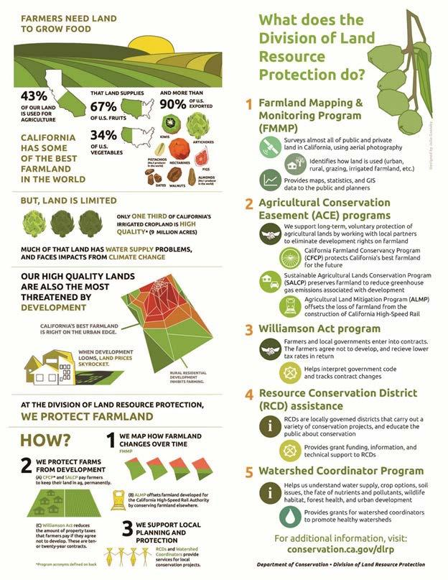
Farmers Need Land to Grow
What evidence is provided by the infographic that explains the importance of farmland in California?
https://www.conservation.ca.gov/dlrp/Pages/Outreach%20Materials.aspx

Slide 12
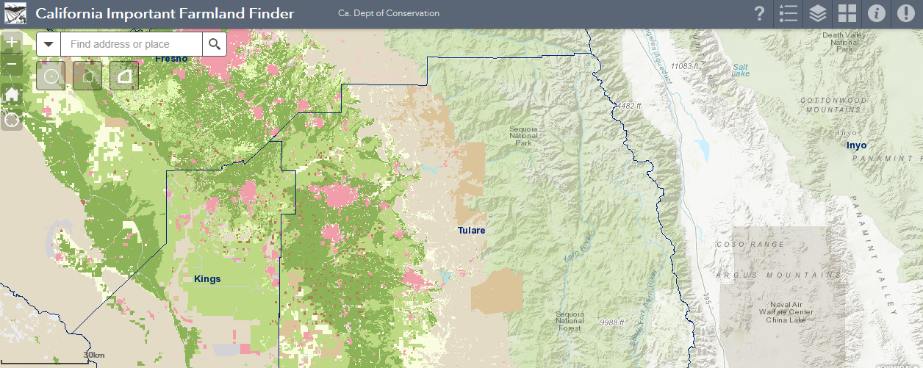
Exploring Local Prime Farmland
Locate the nearest prime farmland near your school. (Use California Important Farmland Finder)
Do you believe that land use has changed over time in our county?

Slide 13
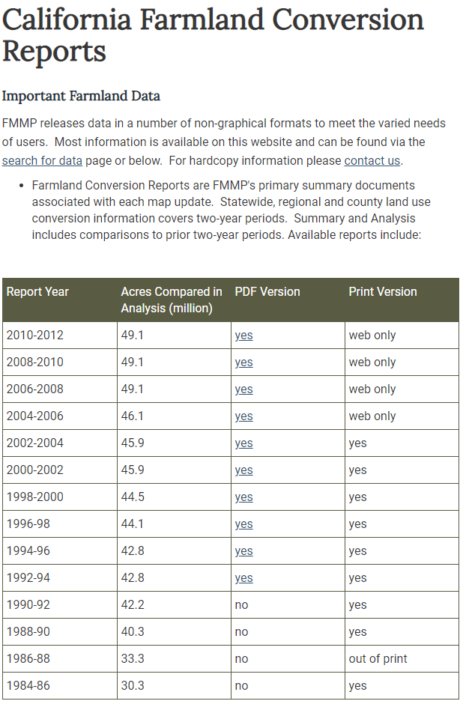
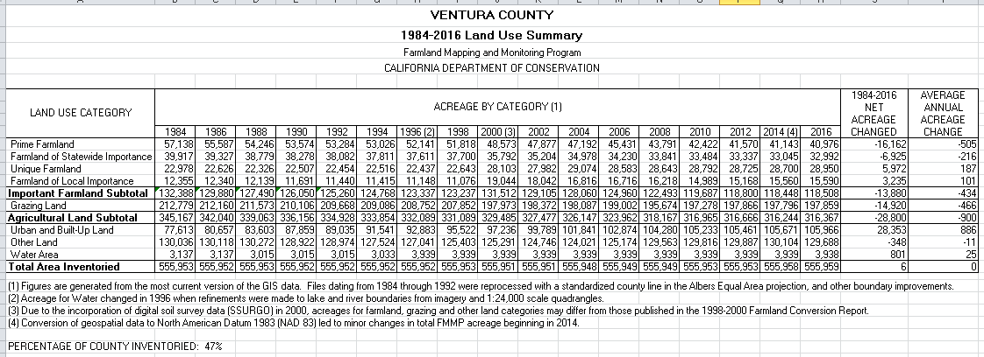
How has land use changed over time in our county?

Slide 14
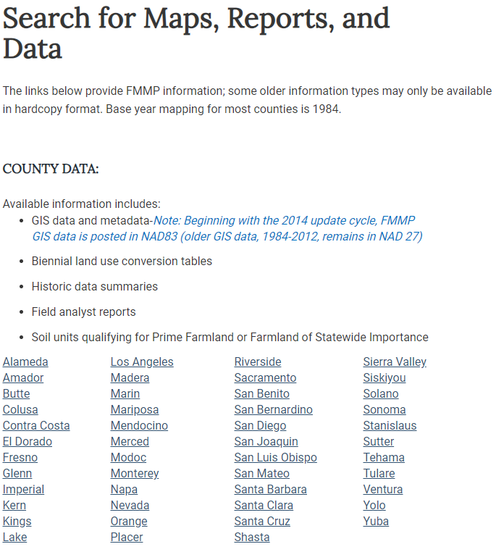
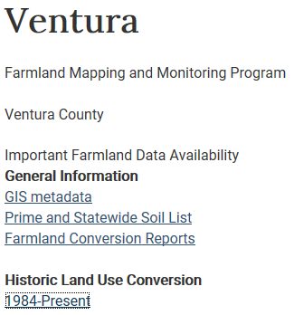
Select your county and identify how much farmland has changed.
Select Historic Land Use Conversion

Slide 15
Farmland Conversion Claim
Analyze the data and make a claim about the conversion of farmland in your county.
Let’s compare your county data with the statewide conversion data.

Slide 16
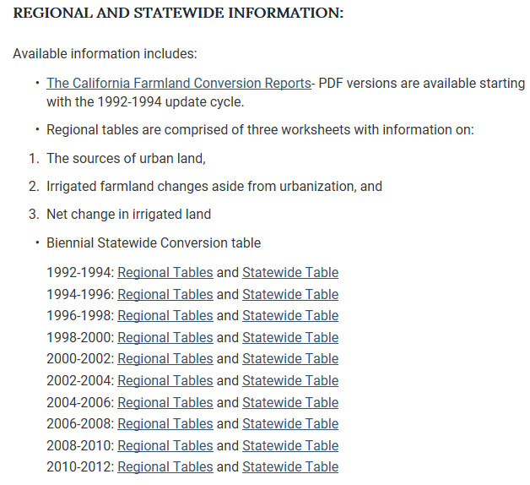
Download and Analyze Statewide Data.
Compare the statewide data to county data to support your claim.
Statewide Table for 2010 - 2012

Slide 17
Fast Facts:
Farm and Grazing lands in California decreased by more than 1.4 million acres between 1984 and 2014. This is larger than the size of Merced County. This loss averages just under 50,000 acres per year, or about one square mile every four days.
The type of farmland with the largest decrease has been Prime Farmland, the best soils for agricultural production. Prime Farmland losses were just under 759,000 acres between 1984 and 2014, larger than the size of Yolo County.
For more Fast Facts go to:
https://www.conservation.ca.gov/dlrp/fmmp/Pages/Fast-Facts.aspx

Slide 18
What is Prime Farmland?
Prime Farmland and Farmland of Statewide Importance, land must meet both of the following criteria:
Land Use: Has been used for irrigated agricultural production at some time during the four years prior to the Important Farmland Map date. Irrigated land use is determined by FMMP staff by analyzing current aerial photos, local comment letters, and related GIS data, supplemented with field verification.
-- AND --
Soil:​ The soil must meet the physical and chemical criteria for Prime Farmland or Farmland of Statewide Importance as determined by the USDA Natural Resources Conservation Service (NRCS).

Slide 19
Change in Land Use Claim
Support your claim with information from the infographic.
https://www.conservation.ca.gov/dlrp/Pages/Outreach%20Materials.aspx

Slide 20
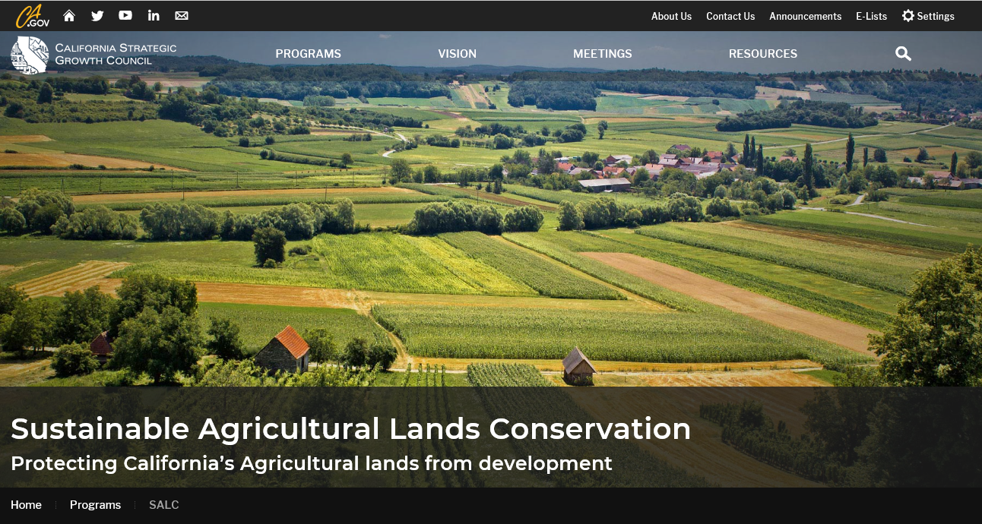
Sustainable Agricultural Lands Conservation (SALC) Program
The SALC program funds projects called easements that protect at-risk agricultural lands from conversion to more intensive land uses such as urban or rural residential
developments.
http://sgc.ca.gov/programs/salc/

Slide 21
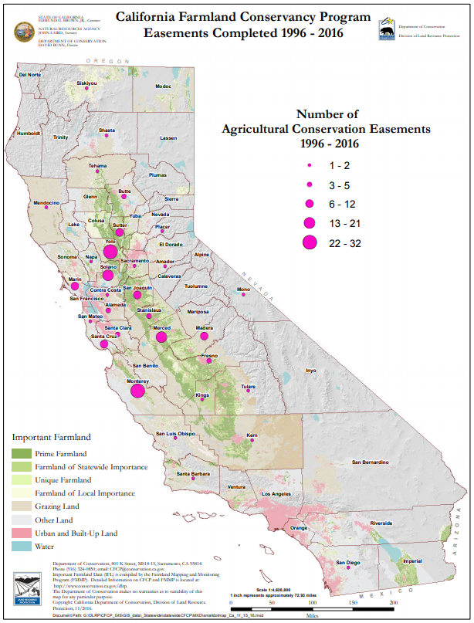
Benefits of Easements
Protects Land by legally protecting it from development
Food Production
Protect Fragile Habitat
Water Protection
Community Separator (Greenbelt)

Slide 22
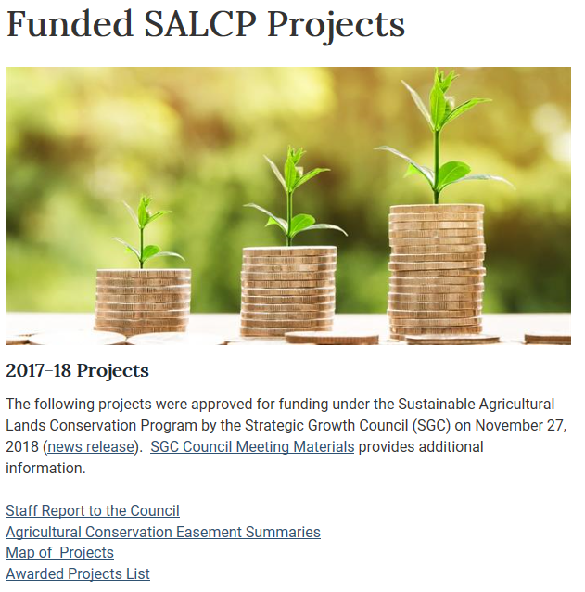
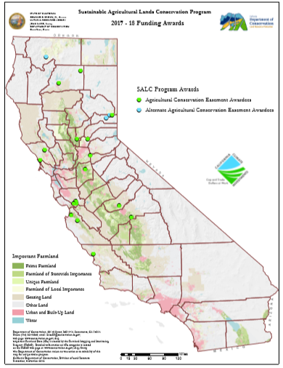
Agricultural Conservation Easement Summaries

Slide 23
SALCP Project
Propose an easement project in your county to protect farmland. Include the following sections in your proposal:
Justification for easement (current status of land use)
Benefits of the easement
Map existing land uses and outline the proposed easement

Slide 24
In Conclusion
We have learned these points about the importance of ag land in California
We benefit by conserving ag land close to urban areas
We should strive to produce more food with less environmental impacts
Perennial grains, legumes, and oilseed crops might provide solutions

Slide 25
In conclusion
We have learned these points about the importance of agricultural land in California:
Benefit of conserving land for agricultural uses proximal to urban areas.
Goal to produce more food with less impact of the environment.
Perennial grains, legumes and oilseed crops might provide solutions.

Slide 26
THANK YOU

